Slide 1

Hybrid Cloud Management
Sarah Lean
Senior Cloud Advocate
Microsoft
@Techielass
www.techielass.com

Slide 2



Who am I?
Cloud Advocate @ Microsoft
Blog at www.techielass.com
@Techielass
Founder of the Glasgow Azure User Group
STEM Ambassador
14+ years in the IT industry
IT Pro

Slide 3
Questions

Slide 4









IT environments are evolving
10s - 1,000s of apps
Diverse infrastructure
Multi-cloud
VMs
Databases
Datacenters
Hosters
Containers
Serverless
Branch offices
OEM hardware
IoT devices
Edge
Microsoft Azure | @Techielass

Slide 5
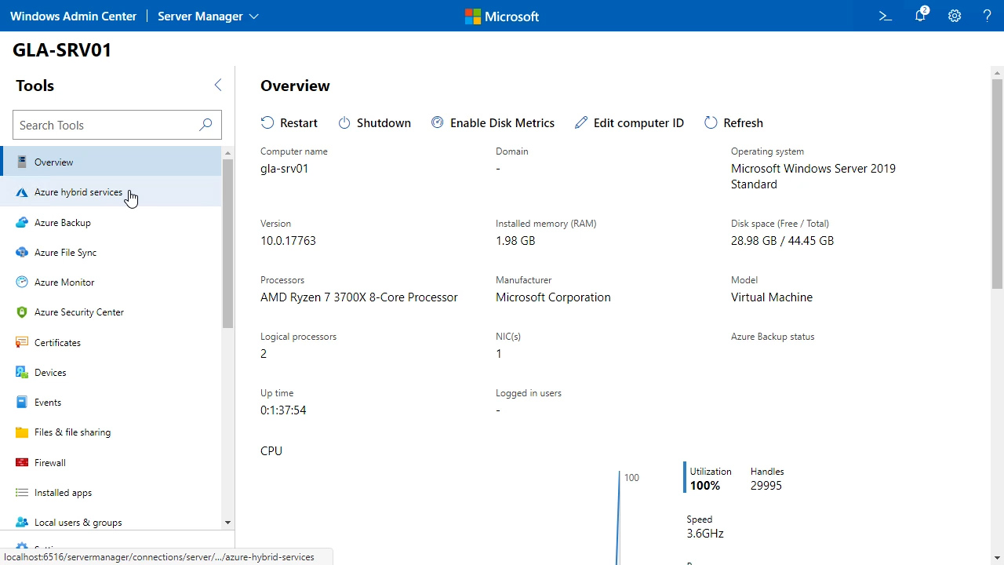
Windows Admin Center
Remote management tool for Windows Servers running anywhere—physical, virtual, on-premises, in Azure, or in a hosted environment—at no additional cost
http://aka.ms/WACDownload
Microsoft Azure | @Techielass

Slide 6
Server management reimagined
Manage systems, including multiple versions of Windows Server
Bolster network security
Keep local files in sync with the cloud
Apply updates
Streamline everyday tasks on premises
Add hybrid capabilities
Monitor server performance
Back up servers
Protect servers intelligently
Predict capacity needs
Resolve server issues
Maximize performance, availability
Microsoft Azure | @Techielass

Slide 7




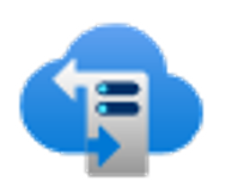



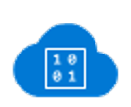





Extend on-premises into Azure
Centrally manage from Azure
Business continuity & disaster recovery
Secure
Monitor
Update
Azure Site Recovery
Azure Backup
Storage Replica
Azure Security Center
Azure Monitor
Azure Update Management
Extend on-premises capacity
Storage
Azure File Sync
Storage Migration Service
Compute
Cloud Witness
Create Azure VM
Azure Arc for Servers
Azure Policy
Networking
Azure Network Adapter
Azure Extend Network
Microsoft Azure | @Techielass

Slide 8





Use cases
General server management using familiar yet modernized tools, such as the reimagined Server Manager and streamlined MMC tools
Single server or cluster troubleshooting, configuration, and maintenance
Remote or branch office systems management
Streamline HCI management, with simplified workflows to create and manage virtual machines, Storage Spaces Direct volumes, Software-Defined Networking, and more
Hybrid operation, which lets you manage Windows Server running anywhere and easily integrate Azure innovation into your datacenter
Microsoft Azure | @Techielass

Slide 9





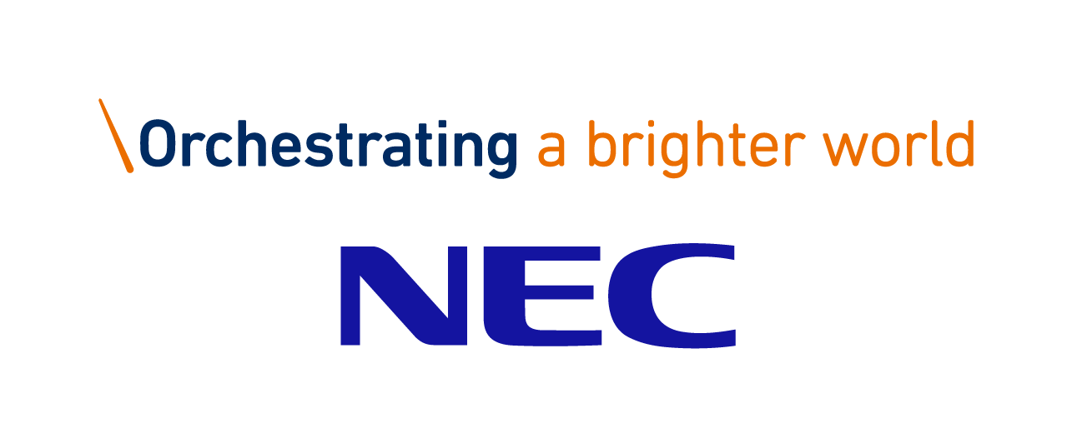


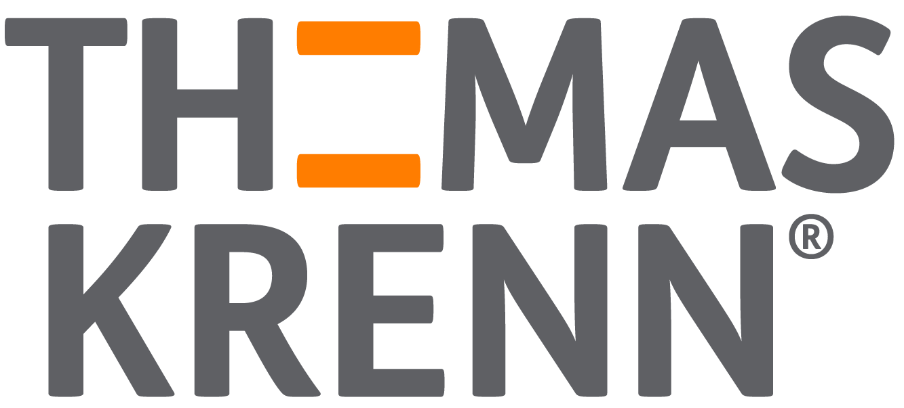
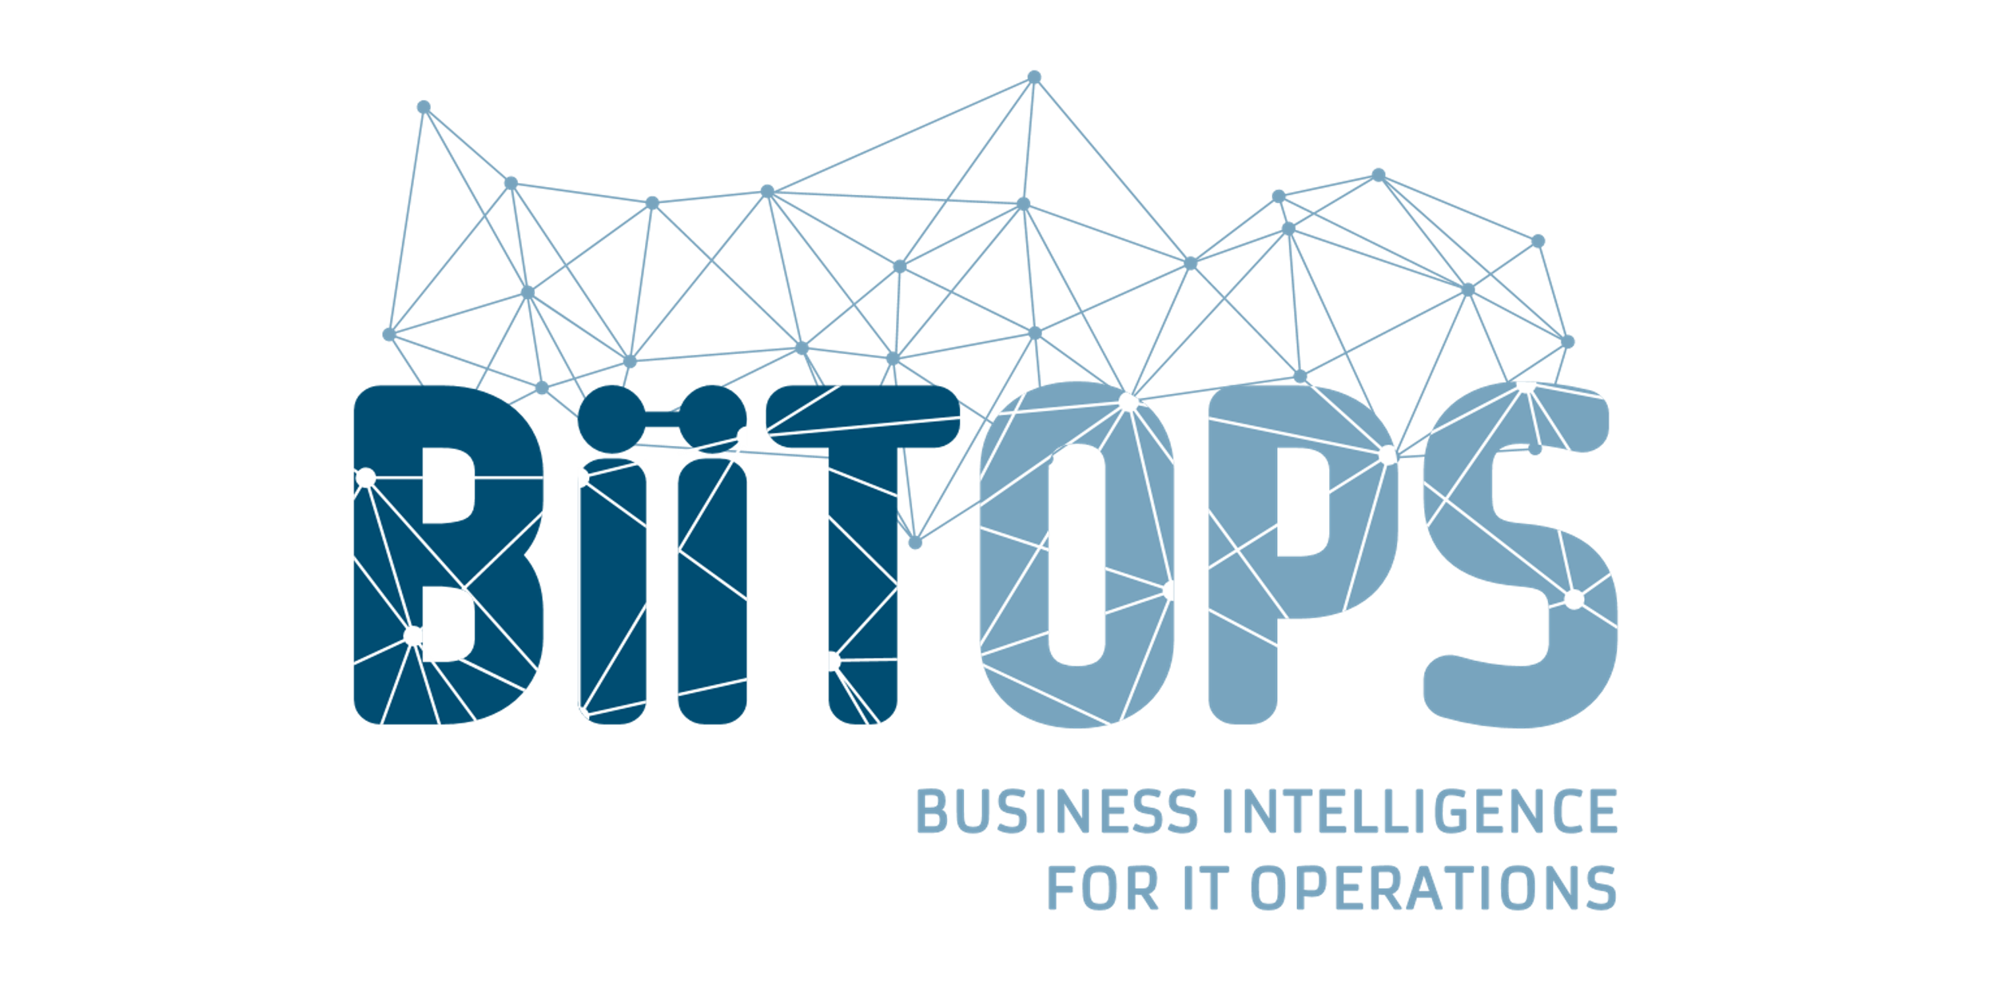
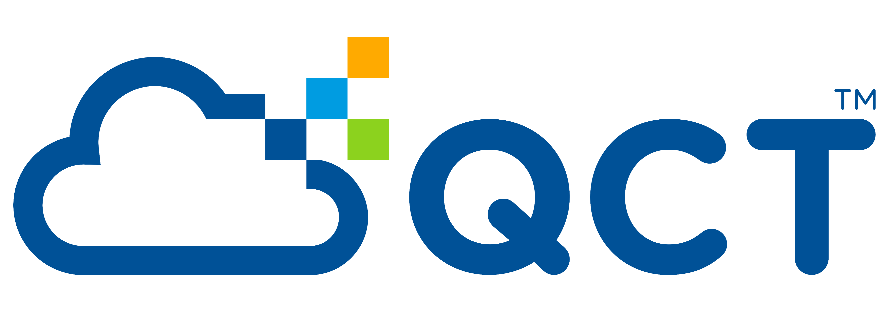
Windows Admin Center Partners
Microsoft Azure | @Techielass

Slide 10
Download today
The small (~60MB) file installs in minutes and is available at no extra cost. Access from a modern web browser.
LEARN MORE
https://aka.ms/hybrid-wac
Microsoft Azure | @Techielass

Slide 11
Demo – Windows Admin Center Overview

Slide 12


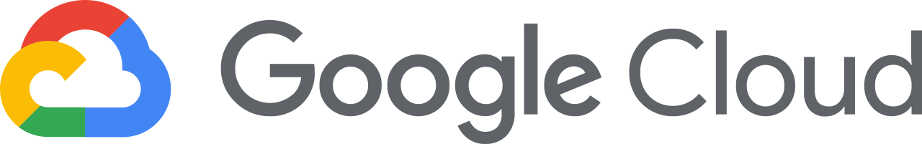

Azure Hybrid
Innovation anywhere with Azure
Azure
Single control plane with Azure Arc
Bring Azure services to any infrastructure
Modernize datacenters with Azure Stack
Extend AI to the edge with Azure IoT
Microsoft Azure | @Techielass

Slide 13
Azure Arc
Bring Azure services and management to any infrastructure
Run Azure Data Services anywhere
Extend Azure management across your environments
Adopt cloud practices on-premises
Implement Azure security anywhere
Azure Arc is a set of technologies that extends Azure management and enables Azure services to run across on-premises, multi-cloud, and edge
Microsoft Azure | @Techielass

Slide 14

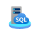

Azure Arc
Add your existing physical and virtual machines from on-premises, edge and multi cloud services.
Add your existing Kubernetes clusters from on-premises, edge and multi-cloud services.
Add your existing SQL server instances from on-premises, edge and multi cloud services.
Deploy and manage Azure data services on your own Kubernetes clusters.
Deploy and manage SQL managed instances on your own Kubernetes clusters.
Deploy and manage PostgreSQL Hyperscale on your own Kubernetes clusters.
Microsoft Azure | @Techielass

Slide 15
Azure Arc Pricing
There's no charge to add and view your on-premises, multi-cloud or edge infrastructure. Charges start when you add additional Azure services.
Microsoft Azure | @Techielass

Slide 16
Demo – On board a server to Azure Arc

Slide 17

Patching Challenges
Both physical and virtual machines, both on-prem and Cloud, running Windows or Linux remain current with software updates
Ability to determine update compliancy
Centralize deployment of software updates
Microsoft Azure | @Techielass

Slide 18
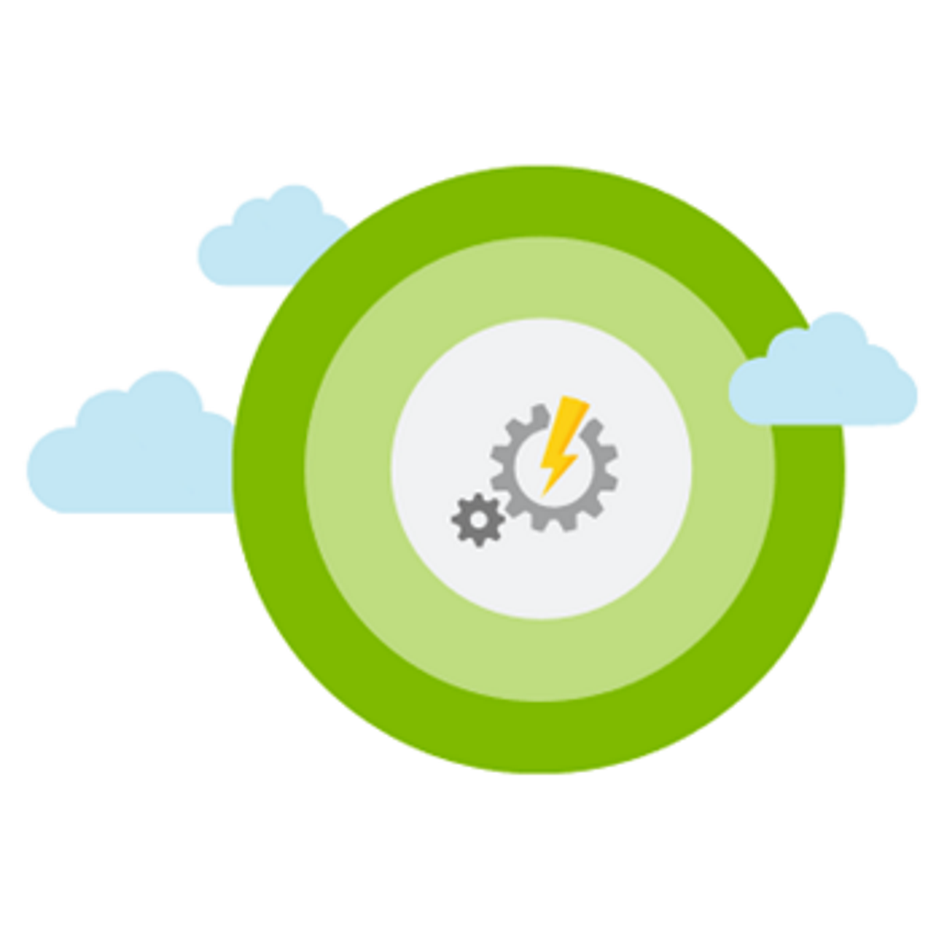
Azure Update Management
Checks update compliance of their Windows and Linux computers, both on-prem and in Azure IaaS
Can deploy and install software updates to Windows and Linux computers, both on-prem and in Azure IaaS
Avoids having to use different products depending on operating system or location
Microsoft Azure | @Techielass

Slide 19
Azure Update Management
Assess update status of servers across your environment
Windows, Linux
Azure, other cloud, on-prem Deploy updates
Custom approval criteria
Single pane of glass
Automated periodic deployments
Verify Compliance
Assess Updates
Deploy Updates
Microsoft Azure | @Techielass

Slide 20





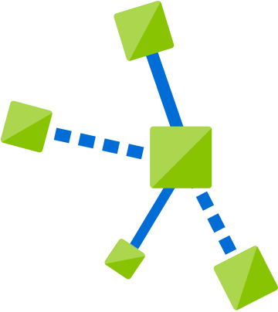

Threat actors leverage a variety of exposures to breach
Exposure
Access
Lateral movements
Actions
Insecure
configuration
Virtual machines
Virtual machines
Data loss
Vulnerabilities
Apps
Apps
Data exfiltration
Infected admin
Credentials
Credentials
Ransomware
Open entry points
Data stores
Data stores
Resource abuse
Exposed credentials
IoT devices
IoT devices
Compromised user
Microsoft Azure | @Techielass

Slide 21

Unmatched security across operations, technology, and partnerships
Operations
Secure foundation and intelligence
$1B annual investment in cybersecurity
3500+ global security experts
Trillions of diverse signals for unique intelligence
Azure Security
Technology
Partnerships
Built-in controls
For a heterogeneous world
Microsoft Azure | @Techielass

Slide 22

Technology
Azure Security
Built-in controls
Identity & access management
Network
Data Security
Threat protection
Security management
Microsoft Azure | @Techielass

Slide 23


Azure Security Center
Strengthen security posture
Protect against threats
Cloud security posture management
Secure Score | Policies and compliance
For servers
For cloud native workloads
For databases and storage
Get secure faster
Microsoft Azure | @Techielass

Slide 24





Security posture management with Secure Score
Evaluated Categories
Gain instant insight into the security state of your cloud workloads
Address security vulnerabilities with prioritized recommendations
Improve your Secure Score and overall security posture in minutes
Speed up regulatory compliance
Access
Compute
SQL server
Network
App
+7%
+2%
+1%
+3%
+2%
Secure Score Impact
50%
Secure Score
Microsoft Azure | @Techielass

Slide 25

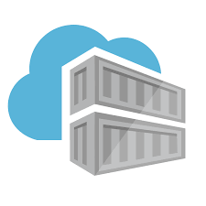
Protect your workloads from threats Use industry’s most extensive threat intelligence to gain deep insights
Detect & block advanced malware and threats for Linux and Windows Servers on any cloud
Protect cloud-native services from threats
Protect data services against malicious attacks
Protect your Azure IoT solutions with near real time monitoring
Azure Security Center
Apps
VMs/
Servers
Containers
SQL
IoT
Network
Management
Cloud workload protection
Microsoft Azure | @Techielass

Slide 26
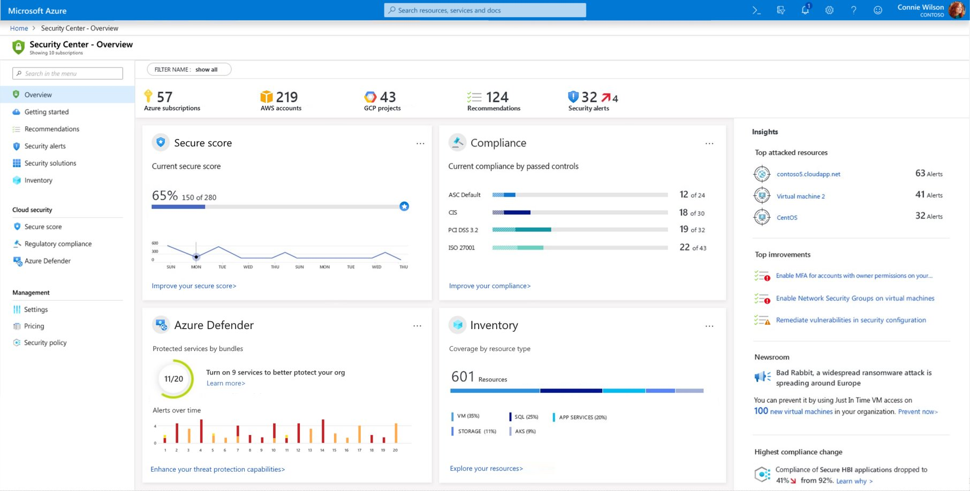
Multi cloud visibility
Microsoft Azure | @Techielass

Slide 27


Security Center Architecture
Threat
Intelligence
Azure
Network & PaaS Netflow, SQL DB and Storage Logs, …
Azure Security Center
Security analytics
Threat Detections, Prescriptive Recommendations
Security Dashboards Deliver Rapid Insights into Security State Across All Workloads
Security Dashboards Deliver Rapid Insights into Security State Across All Workloads
Windows & Linux agents
Windows Events, Syslog, CEF, Configurations
Normalization & enrichment IP Geotagging, …
Actionable Security Recommendations
Curated, Prioritized Security Alerts
On-premises, private and public clouds
Scalable Log Analytics Platform
Investigation Tools and Log Search
Export to Excel and Power BI
REST APIs
Automation
Notifications
Microsoft Azure | @Techielass

Slide 28
Demo – Azure Security Centre Demo

Slide 29

Governance
Resource Organization
Control + Compliance
Environment Deployment
1
2
Microsoft Azure | @Techielass

Slide 30
Azure Policy
Active control and governance at scale for your Azure resources
Enforcement & compliance
Apply policies at scale
Remediate & automate
Turn on built-in policies or build custom ones for all resource types
Real-time policy evaluation and enforcement
Periodic & on-demand compliance evaluation
VM In-Guest Policy
Apply policies to a Management Group with control across your entire organization
Apply multiple policies and & aggregate policy states with policy initiatives
Exclusion Scope
Remediate existing resources at scale
Automate remediation through runbooks, functions and logic apps
Trigger alerts when a resource is out of compliance
Microsoft Azure | @Techielass

Slide 31



Common guardrails
Leverage built-in initiatives & policies
Security
Regulatory Compliance
Tags
Resource standardization
Cost
Azure Security Center
Guest Config baselines
Key Vault certificate
NSG rules
AKS & AKS Engine
RBAC role assignment
NIST SP 800-53 R4
ISO 27001:2013
CIS
PCI v3.2.1:2018
FedRAMP Moderate
Canada Federal PBMM
SWIFT CSP-CSCF v2020
UK Official and UK NHS
IRS 1075
Require specified tag
Add or replace a tag
Inherit a tag from the RG
Append a tag
Allowed/ not allowed RP
Allowed locations
Naming convention
Back up VMs
Allowed images for AKS
Allowed VM SKUs
Allowed Storage SKUs
Microsoft Azure | @Techielass

Slide 32
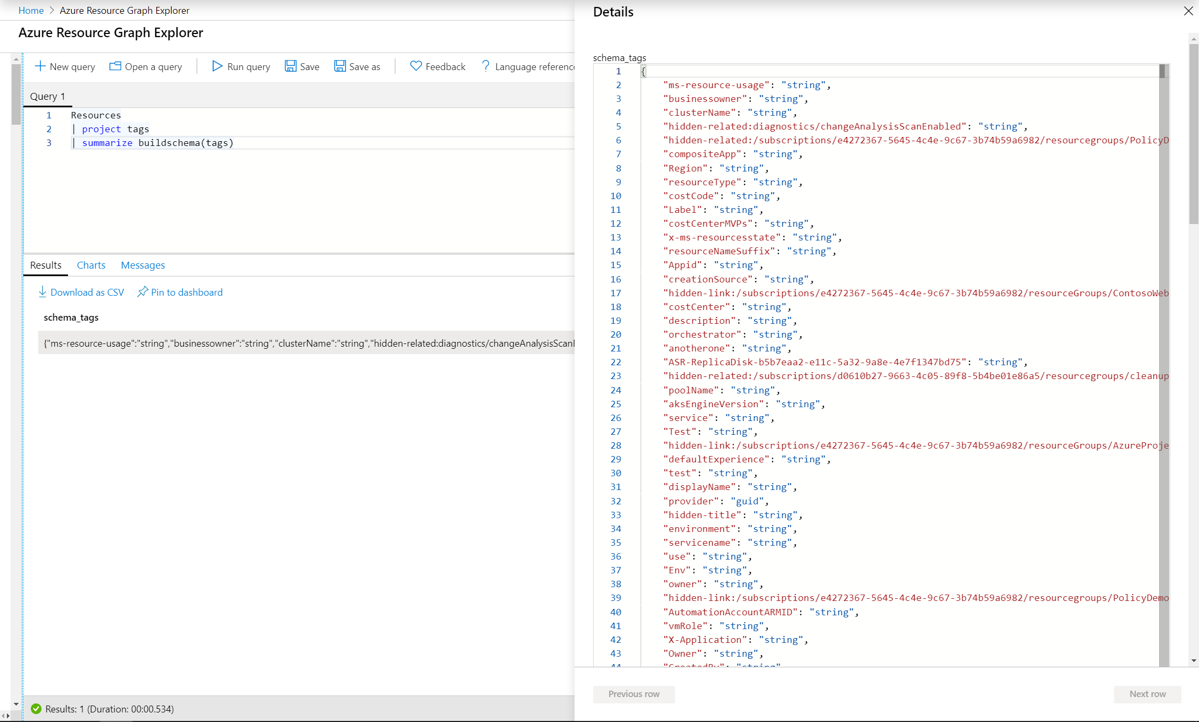
Azure Tags
Tags platform improvement
Tags limit increase – 15 -> 50
Subscription-level tags (coming soon)
Tags contributor role definition (coming soon)
Manage tags with Policy
Automatically apply/inherit/replace/delete on new resources
Remediate existing resources in bulk
Query tags through Resource Graph
Microsoft Azure | @Techielass

Slide 33
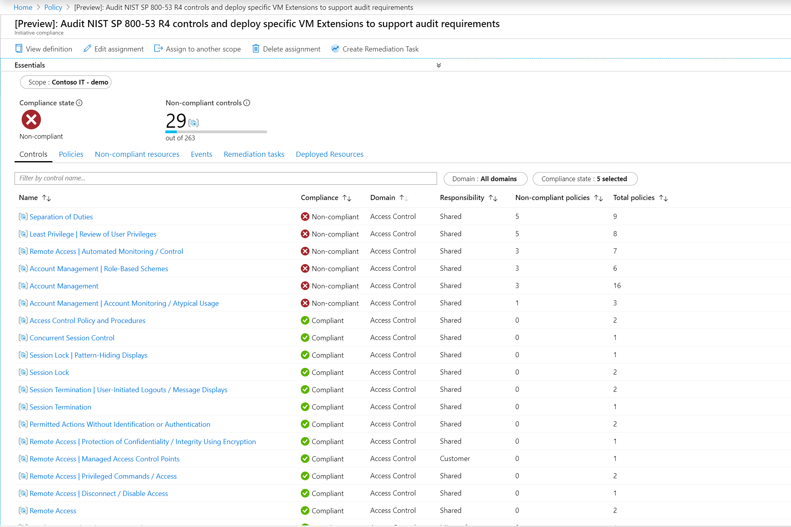
Regulatory Compliance
Built-in initiatives for regulations & standards
Controls & domain constructs within initiative
Azure’s compliance state & implementation details
First-classed experience with Reg Compliance terminologies
Microsoft Azure | @Techielass

Slide 34
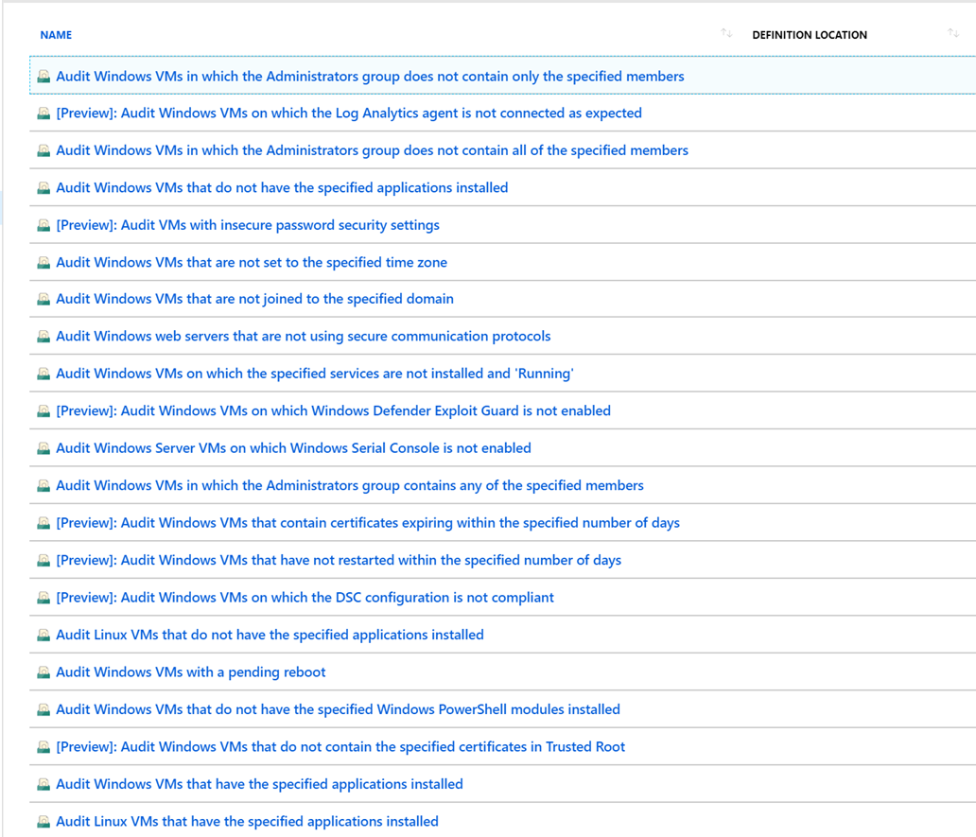
Guest Config Policy
Policy that audit settings within the VM’s guest environment
Azure Policy for In-Guest VM Config DSC v.2 (Windows) and Chef InSpec (Linux)
Configuration of the operating system
Application configuration or presence
Environment settings
Microsoft Azure | @Techielass

Slide 35
Demo – Azure Policy

Slide 36
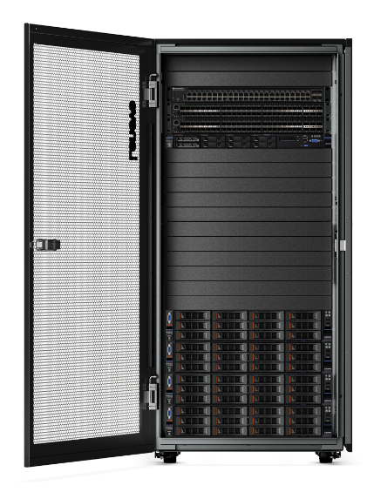
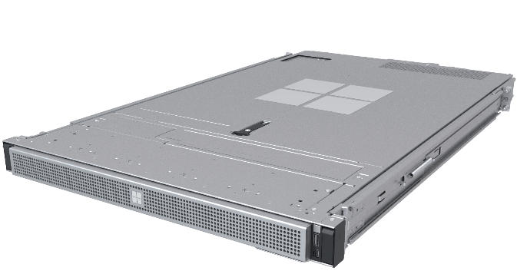
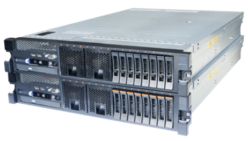
Azure Stack Portfolio
Consistently build and run hybrid apps across on-premises, cloud, and edge
Azure Stack Edge
Cloud-managed appliance
Azure Stack HCI
Hyperconverged solution
Azure Stack Hub
Cloud-native integrated system
Machine learning at the edge
Edge compute and IoT solutions
Network data transfer to cloud
Scalable virtualization and storage
Remote branch office
High-performance workloads
Connected and disconnected
Data sovereignty
Application modernization
Microsoft Azure | @Techielass

Slide 37
Azure Stack HCI solutions
Hybrid operations
Connect to Azure for offsite backup, disaster recovery and cloud-based monitoring
Refresh aging hardware
Software defined infrastructure
Hyperconverged compute, storage and networking based on Hyper-V and Storage Spaces Direct
Consolidate server infrastructure
Validated solutions
Microsoft-validated solution on standard x86 hardware and components from more than a dozen hardware partners
Connect to cloud management
What it is
When to use
Microsoft Azure | @Techielass

Slide 38
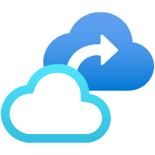
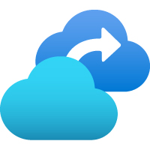

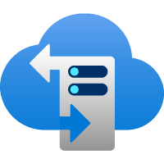
Other Hybrid Tools…
Azure Backup
Azure Site Recovery
Azure Monitor
Azure File Sync

Slide 39

Thank you! Resources: https://aka.ms/hybrid-talk-resources
Sarah Lean
Senior Cloud Advocate
@Techielass
www.techielass.com

